Slide 1
SIT OPEN HOUSE Redemption Module
Final Presentation
Amilyn (224314N)

Slide 2
Table of contents
Project Recap
Modules Features
01
02
Improvements
Design Principles
03
04
Learning Outcomes
Demonstration
05
06
Module workflow and technologies used
Redemption and Master Admin modules functionalities
Adjustments/Improvements made since mid term
Considerations behind UX designs
Key Takeaways from project
Demonstration of Master Admin Page

Slide 3
01
Recap
Module workflow and Technologies used

Slide 4
Redemption Module Workflow
Booth Helper scans visitor’s QR
Verify visitor’s eligibility via API call
If visitor is ineligible, display corresponding message
If visitor is eligible, display redemption form
If visitor already redeemed, display update color form
Booth Helper submits visitor’s color choice via API call
Booth Helper submits visitor’s new color choice via API call

Slide 5
Technologies Used
Programming Languages
IDE Technologies
Cloud Services
ReactJS
Visual Studio Code
Amazon AWS
Source Control
Azure Devops
GIT for Windows

Slide 6
02
Features
Functionalities of Redemption and Master Admin modules

Slide 7
Features - Redemption Module
QR Code Scanner
Eligibility Handling
Color Selection Pop-up
Functionalities:
QR scanner to scan visitors’ QR code.
QR scanner uses phone camera and includes battery saving measures such as:
Stop camera usage on successful scan.
1 minute timeout before stopping camera usage
Functionalities:
Handles what occurs after a visitor’s QR code is scanned.
Renders different content based on visitor’s eligibility, possible cases include:
Eligible
Already Redeemed
Ineligible
Invalid QR scanned
Functionalities:
Display color selection form popup if visitor is eligible / has already redeemed.
Presents available luggage tag color options for selection.

Slide 8
Features - Master Admin Module
Add Booth Stamps
Update Redemption Status
Remove Visitor’s Profile Photo
Functionalities:
Administrator can add booth stamp(s) to visitors ticket.
Functionalities:
Administrator can redeem or update redemption information (tag color).
Functionalities:
Administrator can delete visitor’s profile picture.
Change engraving Text
Update Queue Status
Functionalities:
If visitor’s tag has not been engraved already, administrator can change engraving text.
Functionalities:
If visitor’s tag has not been collected already, administrator can change queue status.

Slide 9
03
Improvements
Adjustments made to Redemption Module based on mid term feedback

Slide 10
Improvements
Automatic starting of phone camera:
Phone camera is automatically launched on page load without user intervention.
QR scanner remains active for a minute, after which user must manually press a button to relaunch camera.
Optimized popup content
Simplified popup content by removing unnecessary components so user need not scroll.
Added form indicators:
Selected color
Current tag color (In update form)

Slide 11
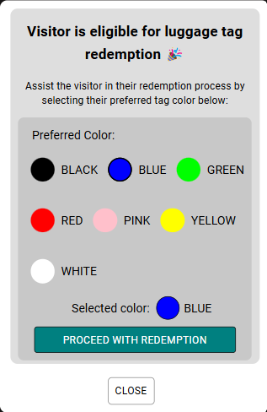
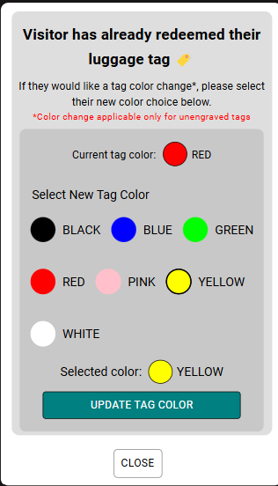
Improvements (cont.)

Slide 12
04
Design
Principals
Skills and knowledge acquired

Slide 13
Design Principles
Mobile Oriented Design
Redemption page is designed with mobile users in mind, content is scaled and optimized for smaller screen sizes.
2. Minimize need for page scrolling
Allow users to view information and perform actions efficiently without scrolling.
3. Visual Feedbacks
Usage of loaders and toast notifications to keep users informed about system states.
4. Responsive Design
Usage of flexible display properties to ensure page design displays nicely across different screen sizes.
Minimalist Designs
Keeping page contents clean and simple to prevent overwhelming users.
6. Content Clarity
Providing indicators (e.g selected color) and instructional text in redemption/update forms to guide users.

Slide 14
05
Learning Outcomes
Skills and knowledge acquired

Slide 15
Learning Outcomes
What I have learnt so far:
ReactJS
Create webpage using ReactJS and Vite
State management (useState, useEffect hooks)
ReactJS components such as:
Axios
React Router
MUI
UI/UX Design Skills
Dynamic rendering of components
Custom components
Mobile Responsive Design
Communication with stakeholders is important.

Slide 16
06
Demonstration
Demo of Master Admin Module functionalities

Slide 17
Thanks!
Any questions?

